Slide 1
Negation in QICore

Slide 2
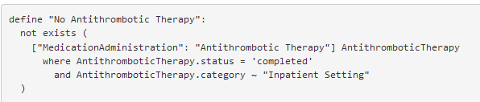

Types of “Negation”
Absence of evidence for a particular event
Documentation of an event that did not occur for a particular reason
https://hl7.org/fhir/us/qicore/2022Sep/index.html#negation-in-qi-core

Slide 3
Documentation of Events Not Done
Documentation needs at least the following:
What – What event did not occur (typically expressed using terminology)
When – When was it documented as not having occurred?
Why – Why the event did not occur (ideally expressed using terminology)
https://hl7.org/fhir/us/qicore/2022Sep/ValueSet-qicore-negation-reason.html
Negation – Explicit indication that the event did not occur
typically captured as a status, but can also be a modifier flag

Slide 4
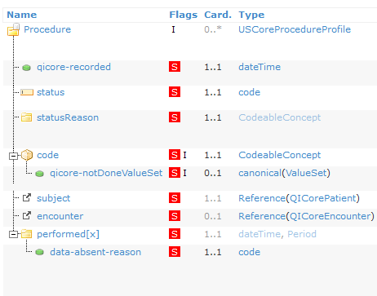
What did not occur?
Two main types of “negative statement”
I didn’t do X
I didn’t do any of Y

Slide 5
Modeled in QICore as a Choice
ProcedureNotDone { code: Choice<Concept, ValueSet>, ... }

Slide 6


Two main types of criteria
Is there evidence that X was not done
Is there evidence that none of Y was done

Slide 7
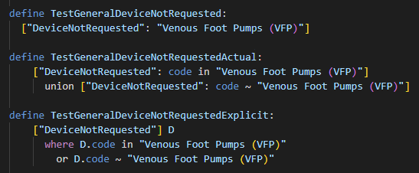
General Not Done
NOTE: Use of this pattern implies a system-level constraint:
There are no positive events that conflict with a negative event
In other words, I can’t say I did something, and I didn’t do something at the same time

Slide 8
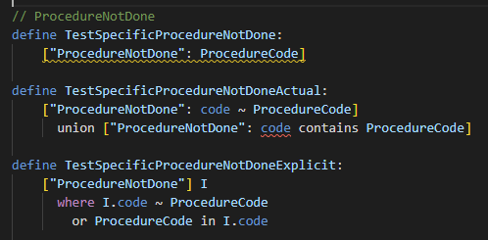
Specific Not Done
The distinction is the same as using a ValueSet vs a direct-reference code in a positive statement
Specific negation is not supported at this time (due to the need for a terminology contains operator in CQL)

Slide 9
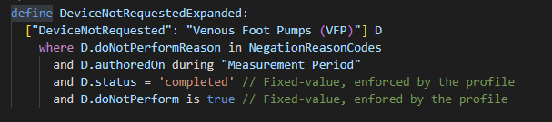
That was just the What
What?
Why?
When?
Negated?

Slide 10

With profile-informed authoring:
What?
Negated?
Why?
When?

Slide 11
What did I not cover?
(or questions?)

